Slide 1
UIT2301 – Programming and Design Patterns
Lecture-02
Serialization

Slide 2
Introduction
To make an object persistent, we need to create a series of bytes that represent the state of the object, and write those bytes to a file.
Serializing: process of encoding objects as a series of bytes
Deserializing: decode objects and their relationships from a series of bytes
Pickle, JSON, YAML – Data serialization languages used for writing configuration files

Slide 3
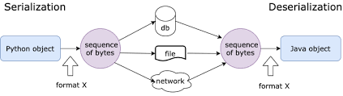
Introduction
Serialization/ Marshalling/ Pickling
Deserialization/ Unmarshalling/ Unpickling

Slide 4
Object serialization using Pickle
The Python pickle module is an object-oriented way to store object state directly in a special storage format.
It essentially converts an object's state (and all the state of all the objects it holds as attributes) into a series of bytes that can be stored or transported however we see fit.
Comprises of 4 functions: two for manipulating file-like objects, and two for manipulating bytes objects so we can work with pickled objects without necessarily having an open file

Slide 5
Pickle Module
dump():
Accepts an object to be written and a file-like object to write the serialized bytes to.
A file-like object must have a write() method, and that method must know how to handle a bytes argument.
This means a file opened for text output wouldn't work; we need to open the file with a mode value of wb

Slide 6
Pickle Module
load():
It reads a serialized object's state from a file-like object.
This object must have the proper file-like read() and readline() methods, each of which must, of course, return bytes.
The pickle module will read the bytes and the load() method will return the fully reconstructed object.

Slide 7
Implementation - Syntax
with open('file2.txt','wb') as f1:
pickle.dump(b1,f1)
with open('file2.txt','rb') as f1:
b1_new=pickle.load(f1)

Slide 8
Object serialization using JSON
JSON – Java Script Object Notation
Common message format for interoperatability
Human readable form
Light weight – Less memory to store

Slide 9
JSON Module
JSON is similar to Python dict
JOSN object has key, value pair
Float,int -> number
List->array
Dict->object
True->true
None->null
Str->string

Slide 10
Functions in JSON module
For serialization:
dumps(): Serializes Python object to JSON string
dump(): Serializes a file
For Deserialization:
loads(): Deserializes a string
load(): Deserializes a JSON file

Slide 11
Implementation - Syntax
#serializing json string
json_str=json.dumps([ball_1,ball_2])
print(type(json_str))
#serializing json file
with open('file2.json','w') as f2:
json.dump([ball_1,ball_2],f2, indent=4)
with open('file2.json','r') as f2:
a=json.load(f2)

Slide 12
Object Serialization using YAML
Human-friendly data serialization language
Python package to parse YAML data - import yaml

Slide 13
Implementation
import yaml
with open('patient.yml','r') as f:
file_1=yaml.safe_load(f)
print(type(file_1))
print(file_1)
print(file_1['patient_details']['phone'])
with open('patient1.json', 'w') as file:
yaml.dump(file_1, file)
with open('patient1.json','r')as file:
file_2=yaml.safe_load(file)
print(type(file_2))
print(file_2)
YAML: The Missing Battery in Python – Real Python

Slide 14
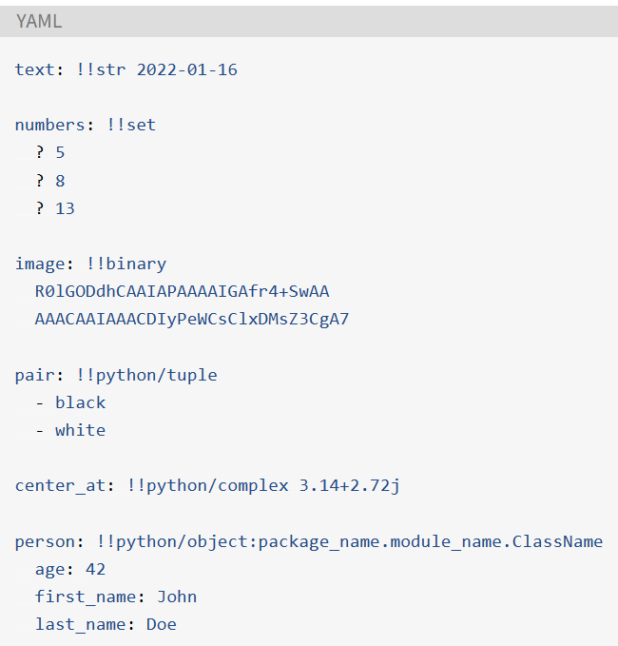
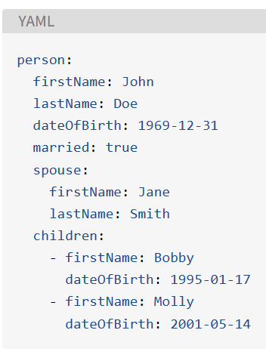
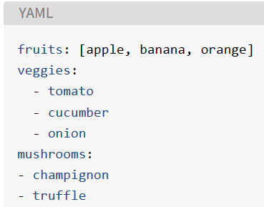
Example

Slide 15
What is XML?
eXtensible Markup Language (much like HTML)
Store and transfer data in webpages, applications
Just the information wrapped up in <Tags>

Slide 16
XML Features
Designed to carry data; not to display data
Self descriptive
No predefined tags like HTML
User must define his own tags
Platform independent & language independent
Configures frameworks (in Android)
Client ←→ Server:
HTML – Layout, data
XML – Just data

Slide 17
XML Structure
Tree Structure
Root element (only one) and child elements
Opening tag must have a closing tag
Case sensitive

Slide 18
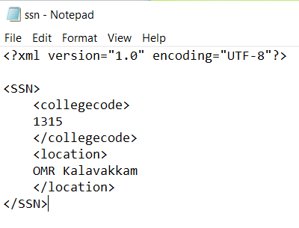
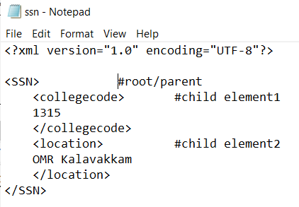
XML Structure - Example

Slide 19
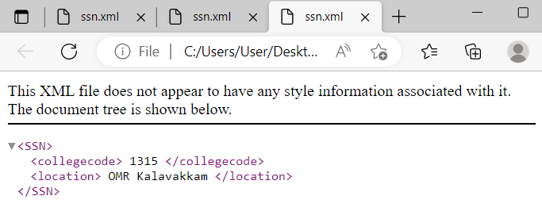
XML Structure - Example
In Browser:

Slide 20
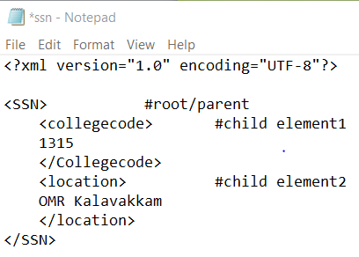
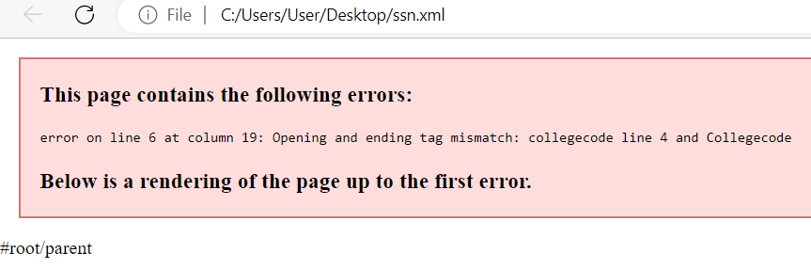
XML Structure – Case Sensitive

Slide 21
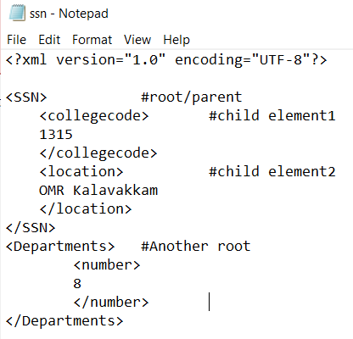
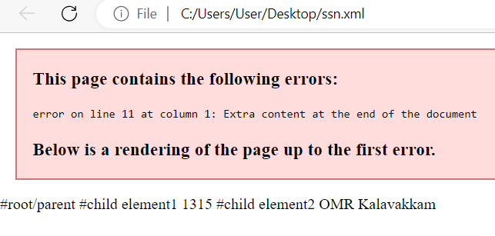
XML Structure – Contains only one root element

Slide 22
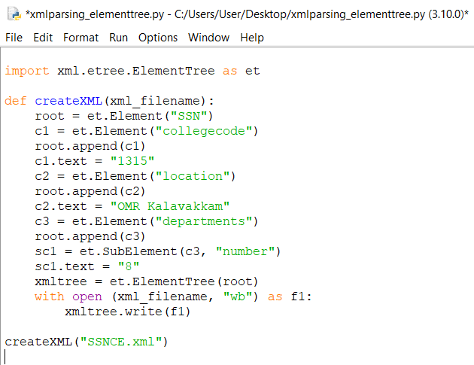
Creating an XML file using ElementTree module:

Slide 23
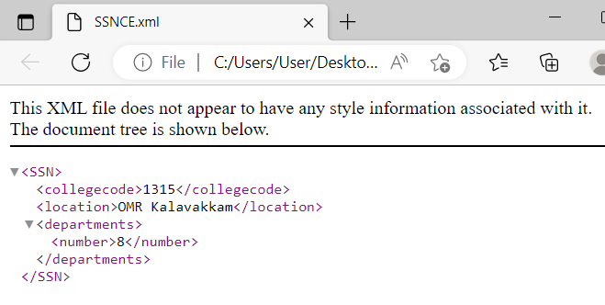
Creating an XML file using ElementTree module:

Slide 24
XML Parsing in Python
Parsing - Reading the data from the different file and splits it into the different pieces that are the XML file
Process of reading an XML document and providing an interface to the user application for accessing the document

Slide 25
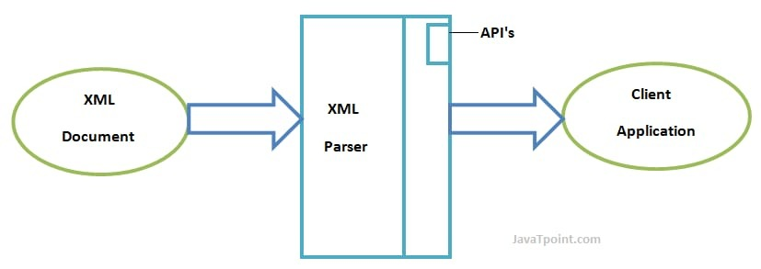
XML Parsing
XML Parser – Software library or package that provides interfaces for client applications to work with xml documents
Xml.etree and ElementTree – used for parsing XML in python

Slide 26
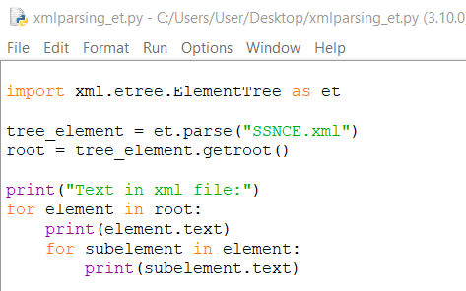
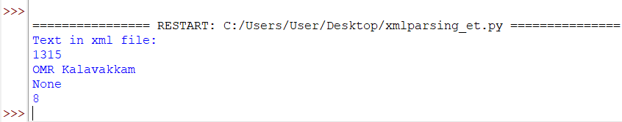
XML Parsing using ElementTree module:

Slide 27
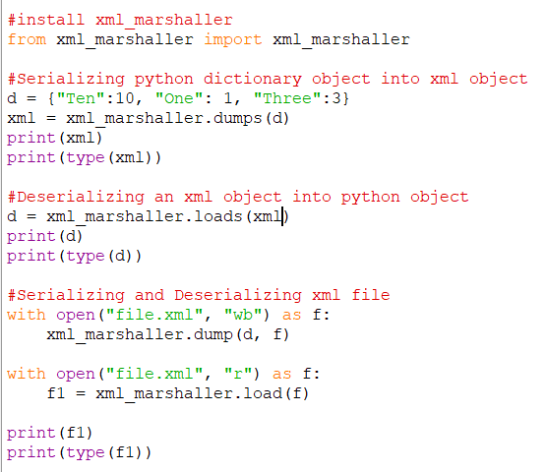
XML Serialization and Deserialization with Dictionary object

Slide 28
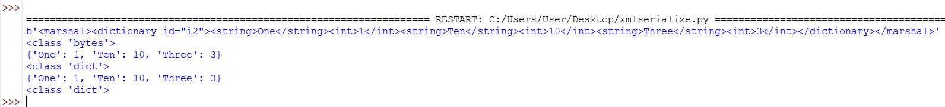
XML Serialization and Deserialization with Dictionary object

Slide 29
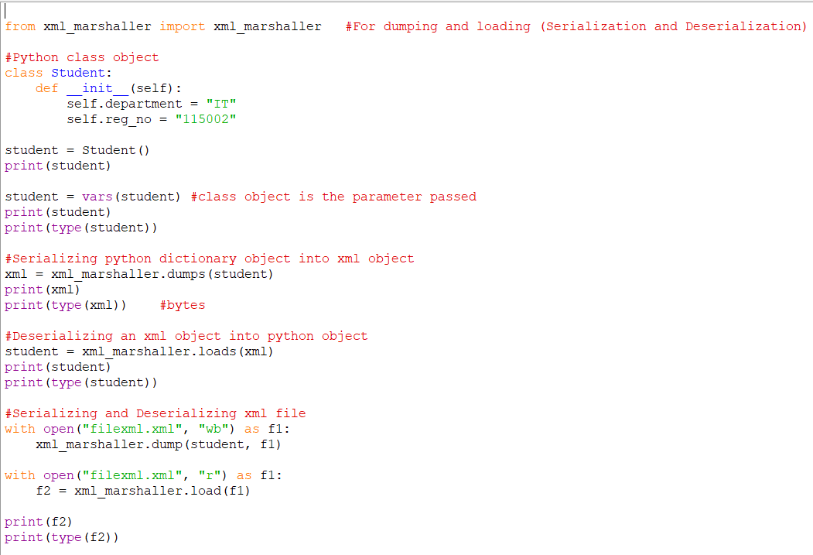
XML Serialization and Deserialization with Class object

Slide 30
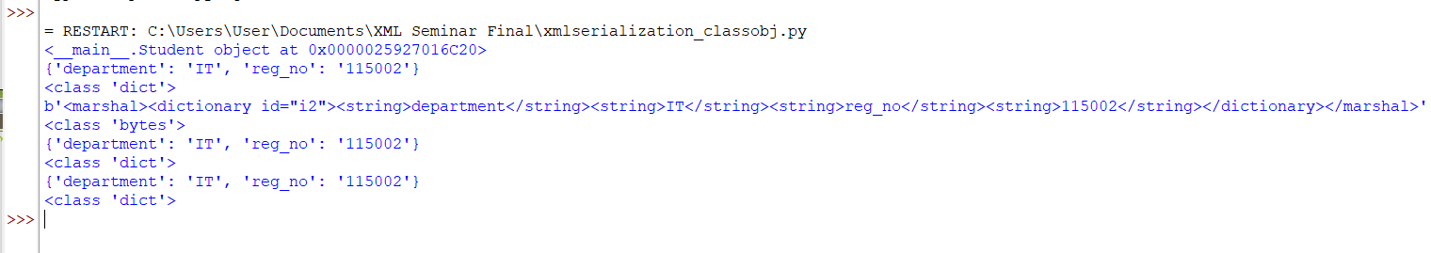
XML Serialization and Deserialization with Class object

Slide 31
Books
TEXTBOOKS:
Dusty Phillips, “Python 3 Object-Oriented Programming: Build robust and maintainable software with object-oriented design patterns in Python 3.8”, Third Edition, Packt Publishing, 2018.
REFERENCES:
Matt Weisfeld, “Object-Oriented Thought Process”, Fifth Edition, Addison-Wesley Professional, 2019.
Matthias Noback, “Object Design Style Guide”, Manning Publications, 2020.
Stephen F. Lott, “Mastering Object-oriented Python”, Second Edition, Packt Publishing, 2019.
Mark Lutz, “Programming Python: Powerful Object-Oriented Programming”, Fourth Edition, O’Reilly Media, 2011.

